Slide 1
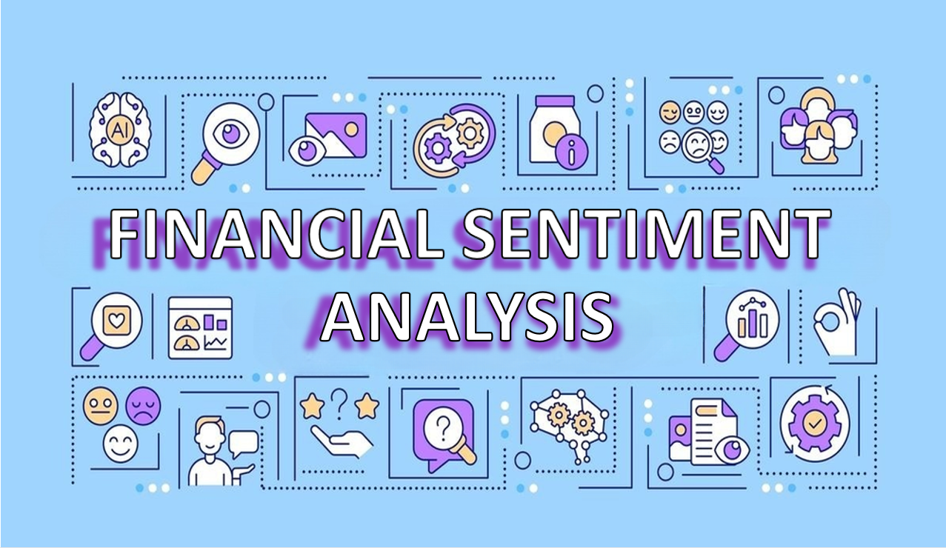

Slide 2
Financial Sentiment Analysis Project
Presented by
(Group No. 5)
Shashikumar D
Gadipelli Mamatha
Khwaja Juned
Dadi Yogitha
Surya Kanth
MULUMUDI SWAPNA
Mr. Chakrapani A M

Slide 3
Introduction
Financial sentiment analysis is the process of extracting and analyzing the opinions, emotions, and attitudes expressed in financial data such as news articles, social media posts, and company filings.
It is used to gain insights into the market sentiment about a particular company or financial asset, which can be useful in making investment decisions.
Sentiment analysis in finance involves applying natural language processing (NLP) techniques to automatically categorize the sentiment of financial news articles, tweets, and other data sources as either positive, negative, or neutral.
The output of sentiment analysis can be used to determine market sentiment about a particular asset or company, and can be used to predict future price movements

Slide 4
Business Objective
Sentiment analysis aims to determine the sentiment strength from a textual source for good decision making. This work focuses on application of sentiment analysis in financial sentiment
Need to get sentiment analysis of financial statements and gauge its impact i.e. positive, negative or neutral on the business and government.

Slide 5
Index
Finding problem statement
Exploratory data analysis
Data visualization
Feature engineering
Model building & Model evaluation
Model deployment

Slide 6
Problem Statement

Slide 7
Problem Statement
Sentiment analysis aims to determine the sentiment strength from a textual source for good decision making. This work focuses on application of sentiment analysis in financial sentiment. This work focuses on application of sentiment analysis in financial news

Slide 8
Exploratory Data Analysis

Slide 9
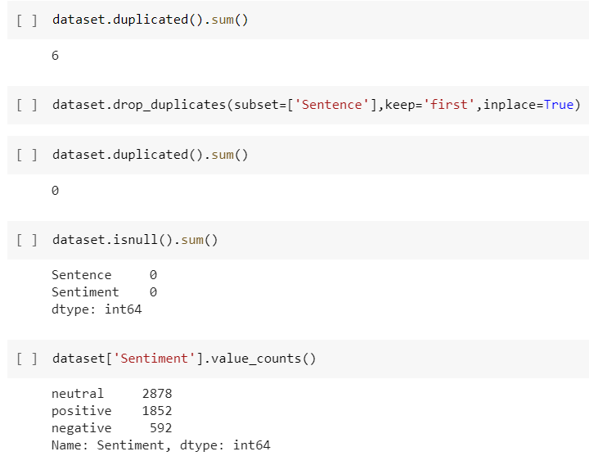
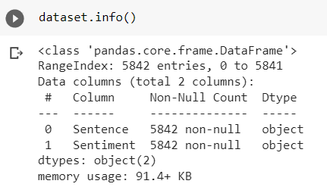
EDA
Exploratory Data Analysis (EDA) is an important step in understanding and gaining insights from sentiment of each class Positive , Negative and Nuetral.
The aim of EDA is finding missing values and duplicate statement, and dataset information.

Slide 10
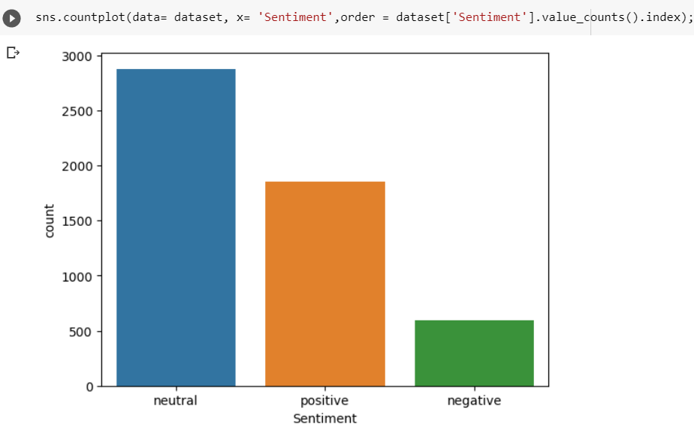
Bar Graph

Slide 11
Text Pre-processing
The preprocessing steps for text data are different from the traditional data preprocessing for structured data. Some common NLP data preprocessing techniques include
Tokenization: Breaking down the text into individual words or phrases (tokens)
Stop-word removal: Removing common words like "a", "an", "the", etc. that do not carry meaning
Stemming or Lemmatization: Reducing words to their base form to reduce the dimensionality of the data
Removing punctuation and special characters
Lowercasing or uppercasing all text
Removing numbers
Removing whitespaces
Removing HTML tags

Slide 12
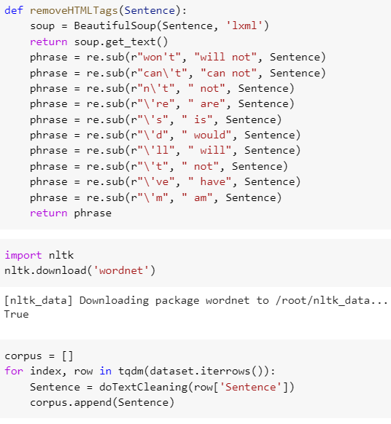
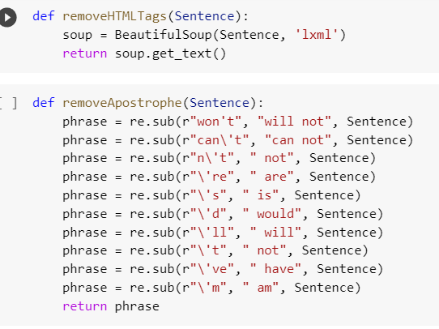
Text Pre-processing of ML Model

Slide 13
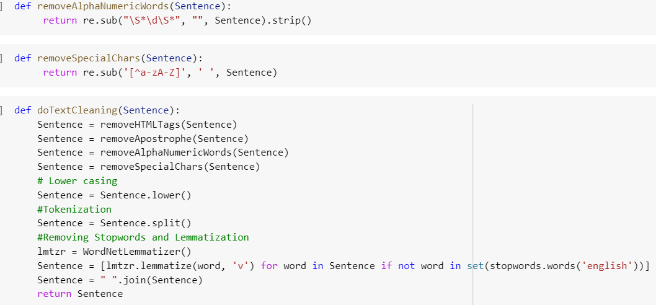
Text Pre-processing of ML Model

Slide 14
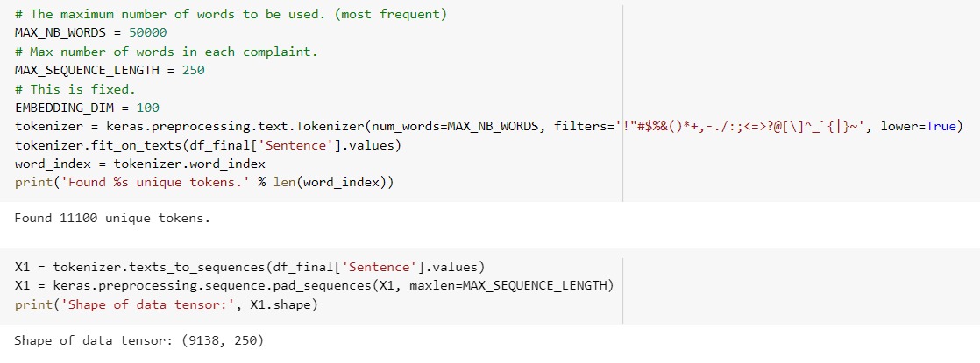
Text Pre-processing of DL Model

Slide 15
Data Visualization

Slide 16
Data Visualization
Data Visualization is the graphical representation of information
Visualizations achieved in this project are:
Bar Graph
Wordcloud
Histogram

Slide 17
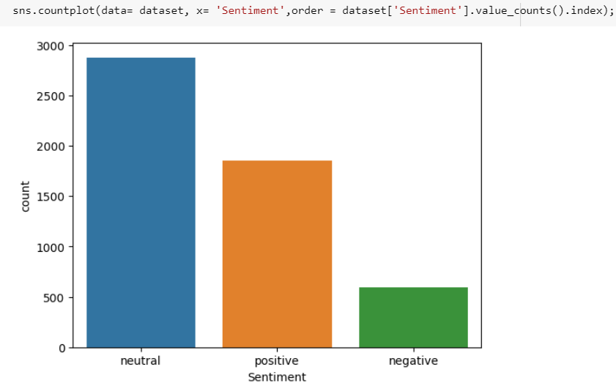
Bar Graph plotting target feature distribution
From the above graph shows there is imbalance in the all Class

Slide 18
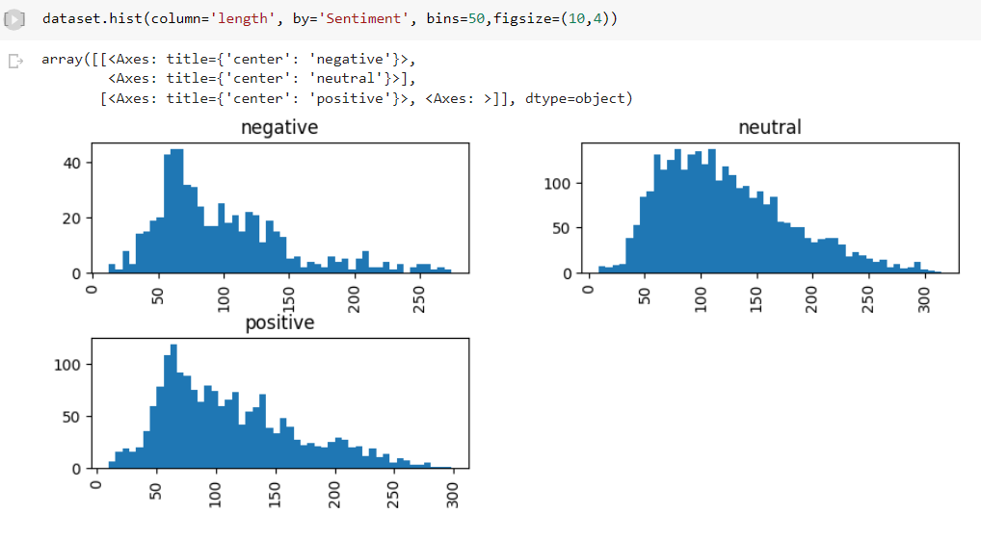
Histogram
This method is used to show the skewness of the each Class using Sentence length.
Histogram has showing all the class are Right sckew

Slide 19
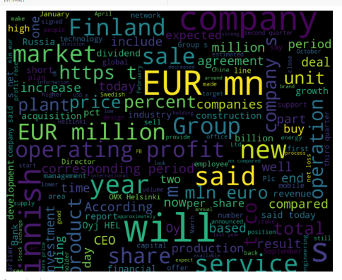
Word Cloud
Word cloud will showing most accruing words in large and least accruing words are Small

Slide 20
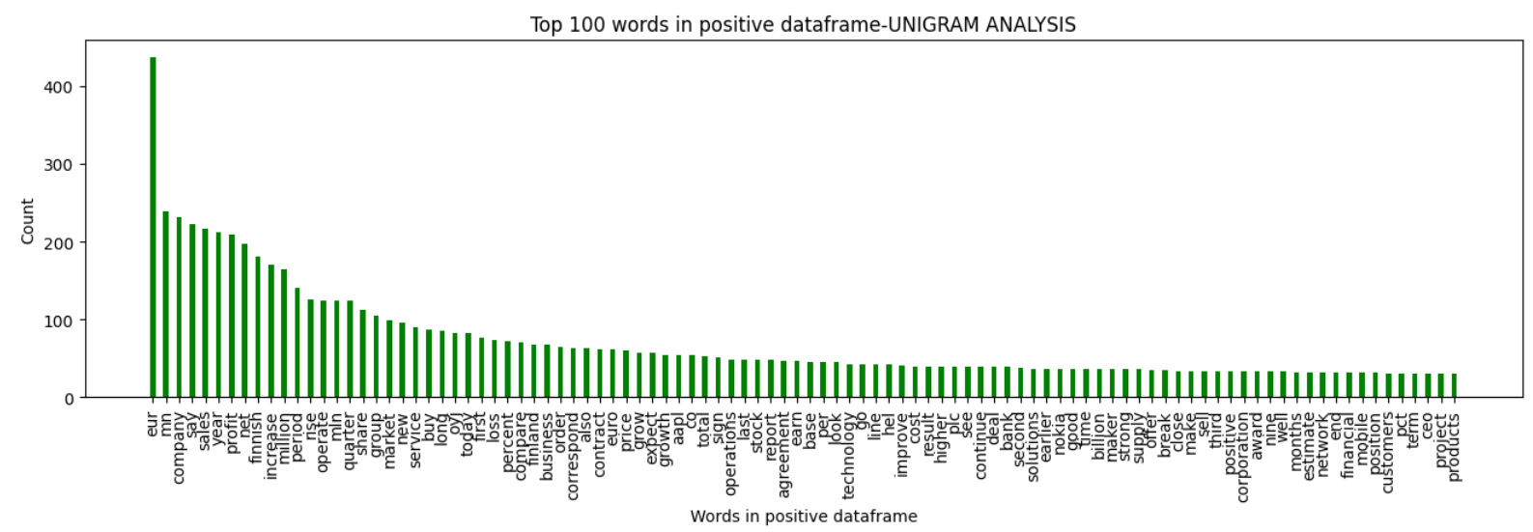
Bar Plot for Unigram
Bar chart shows top 100 most accruing words

Slide 21
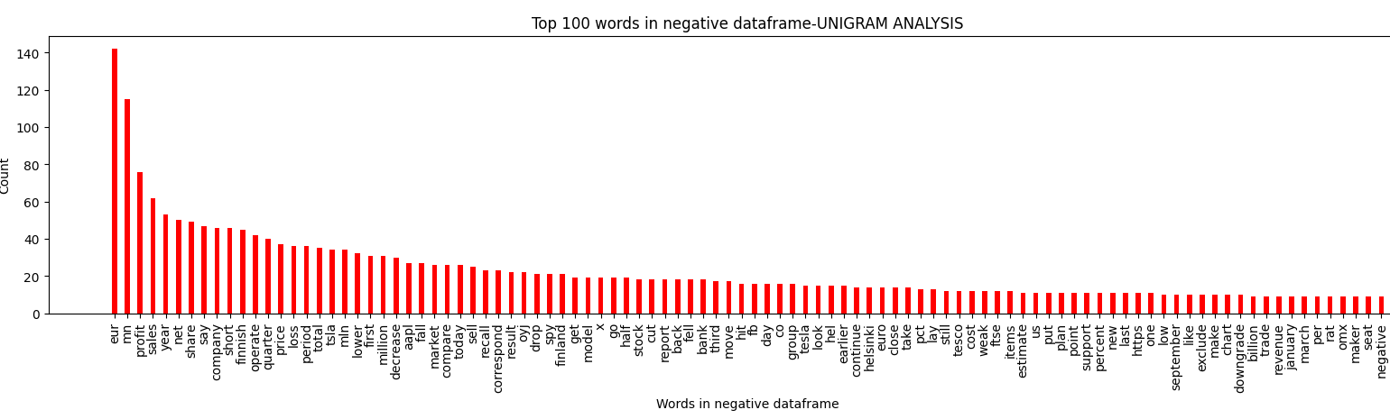
Bar Plot for Unigram
Bar chart shows top 100 most accruing words

Slide 22
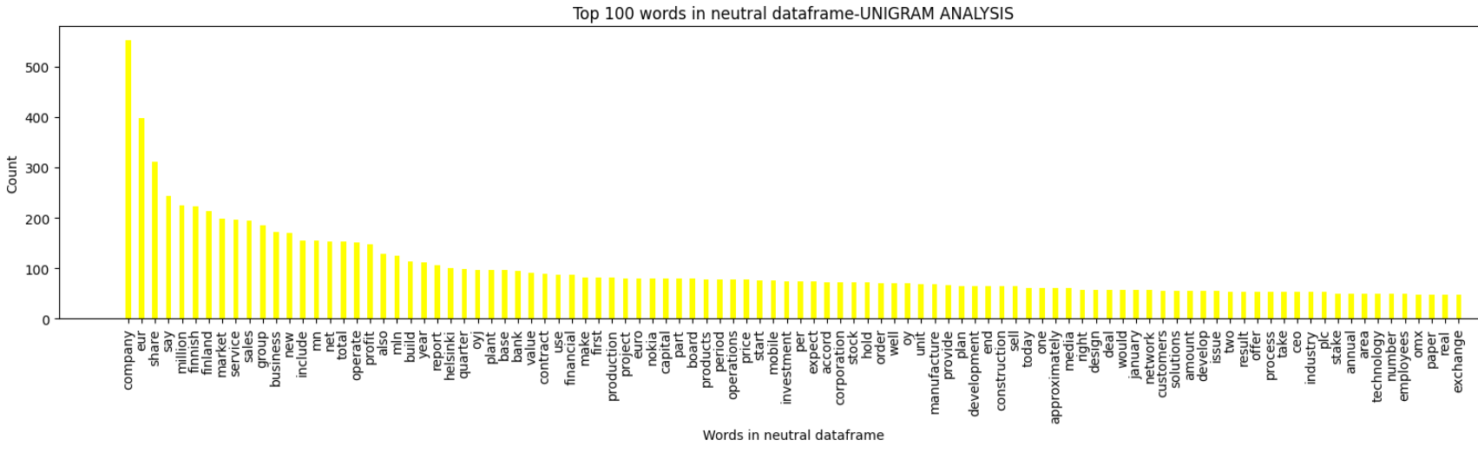
Bar Plot for Unigram
Bar chart shows top 100 most accruing words

Slide 23
Feature Engineering

Slide 24
Feature Engineering
1
Label encoding
2
Feature Transform
3
Data Balance
Splitting Data into Test & Train
2) Tokenizer
1) Counter vectorization
Features extraction

Slide 25
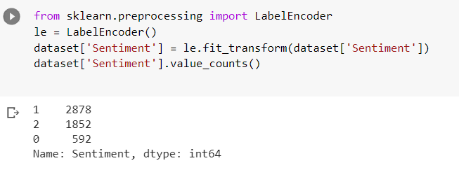
Label Encoding
Label encoding is one method of converting data to prepare it for an algorithm and get a better prediction.

Slide 26
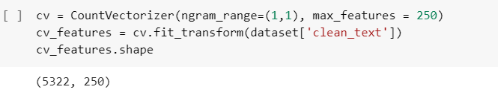
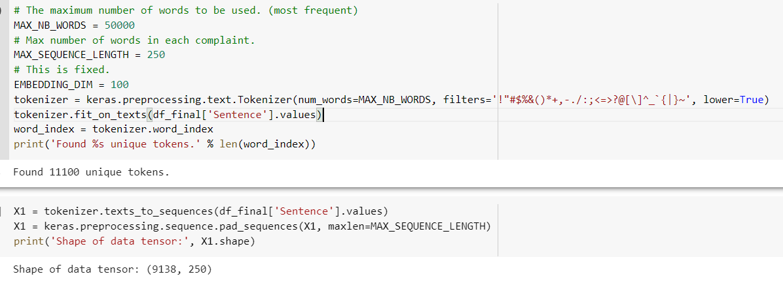
Feature transform and Extraction

Slide 27
Model Building and Evaluation

Slide 28

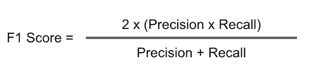


MODEL EVALUTION
Model evaluation is the process of using different evaluation metrics to understand a machine learning model's performance, as well as its strengths and weaknesses.
Precision (Positive Predicted Value)
Recall (Sensitivity, True Positive Rate)
Receiver-Operator Curve (ROC Curve)
Area Under the Curve (AUC)
Accuracy
F1- score

Slide 29
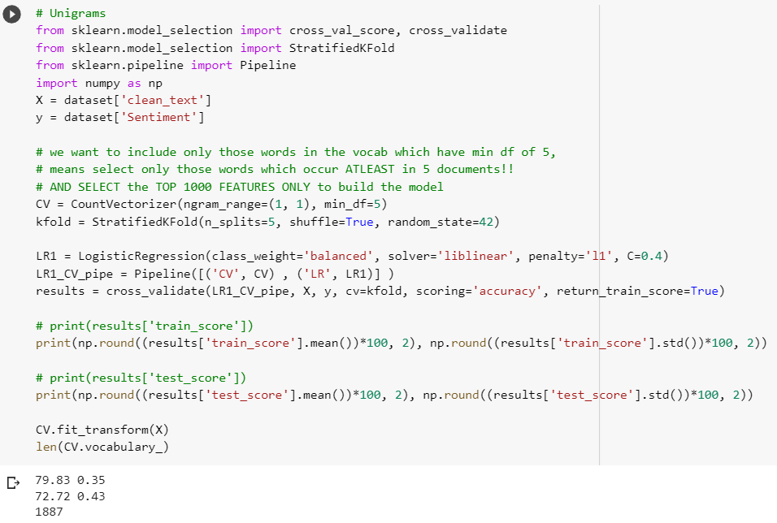
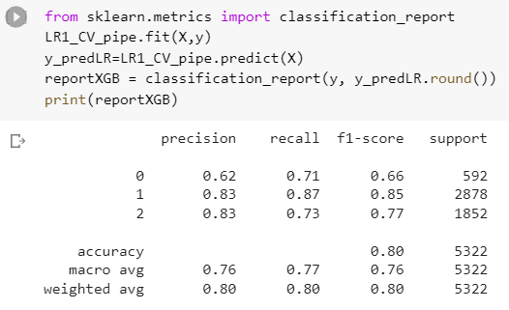
Logistic Regrestion

Slide 30
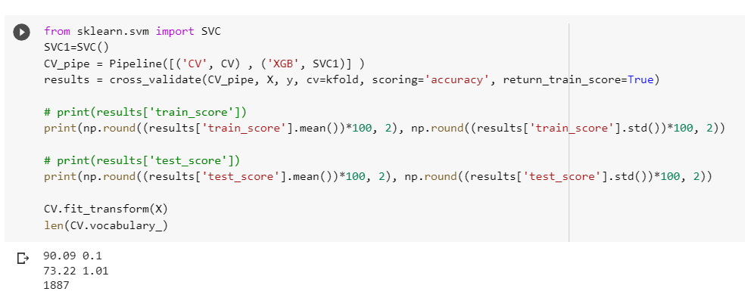
SVC

Slide 31
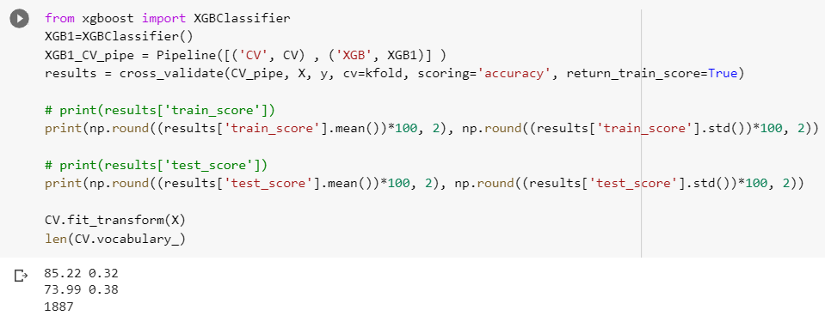
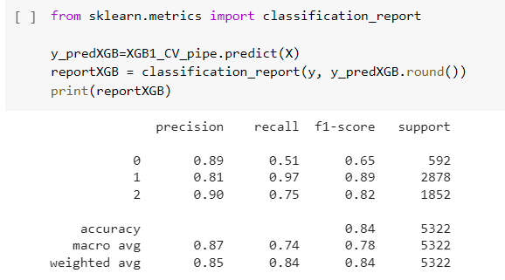
XGBoost Classifier

Slide 32
Sentiment Count Before Data balance
Target variable having imbalanced data so we need to Balance data by Resampling method to Up sampling because data set is small

Slide 33
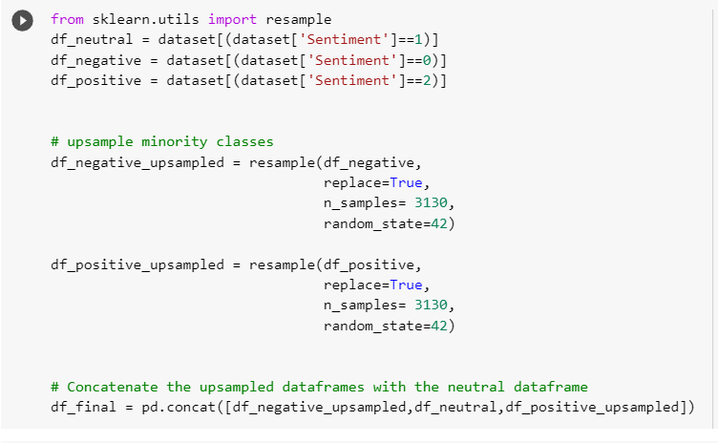
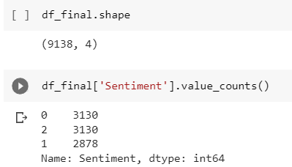
Sentiment Count After Data balance
Here, data is balance for target variable ‘Sentiment’.

Slide 34
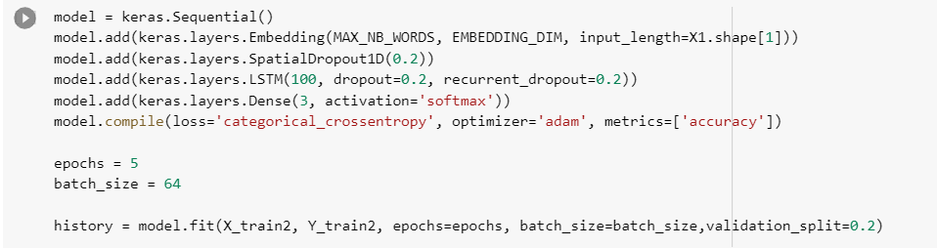
Model Building Using Neural network

Slide 35
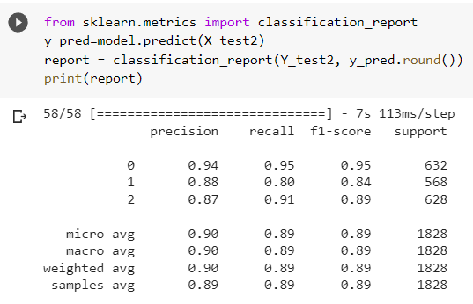
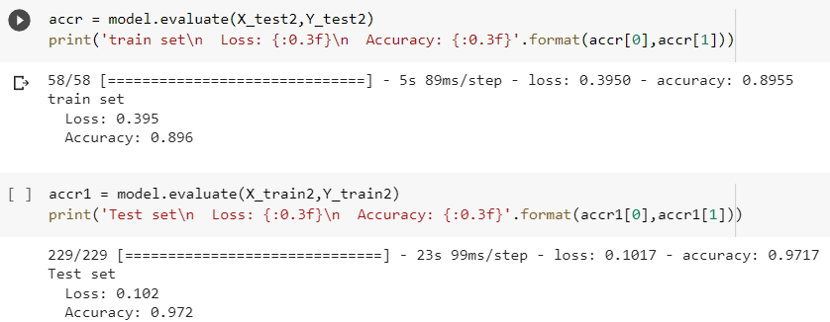
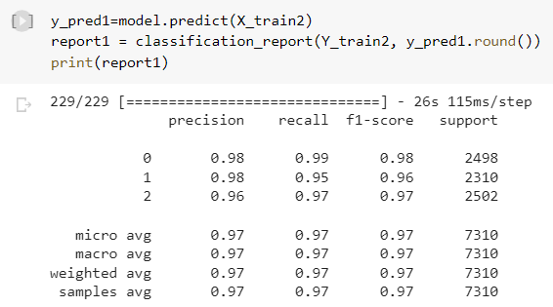
Neural network Model evalution

Slide 36
Model Deployment

Slide 37
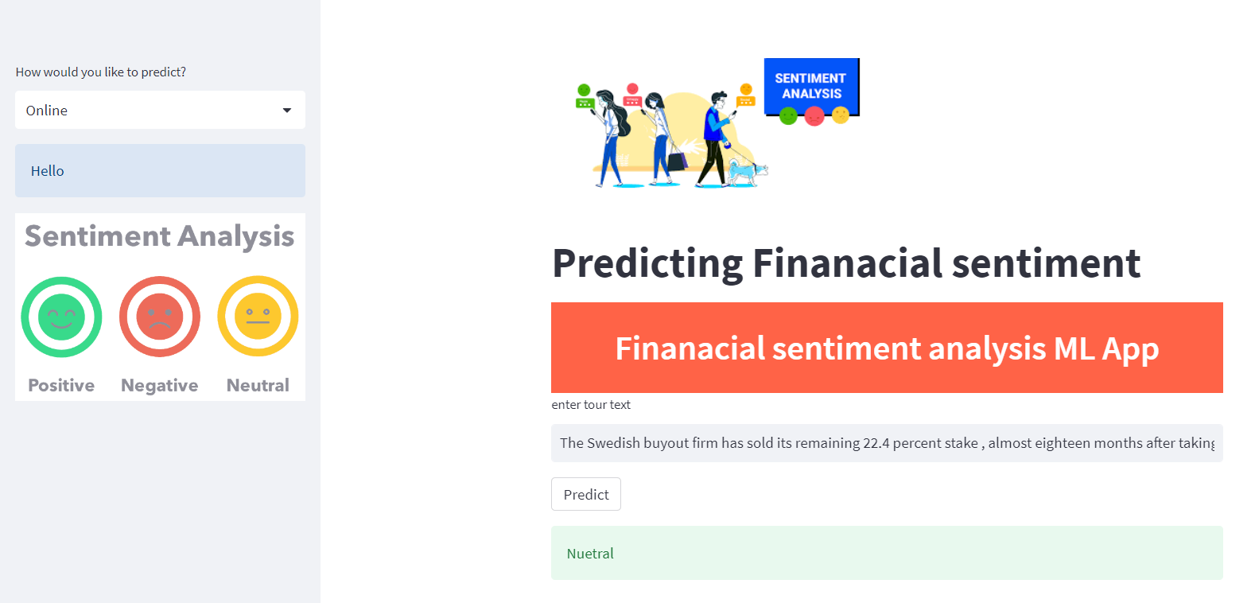
Deployment Of ML
Create pickle file
2. Install required libraries
4. develop app by using python
5. Using local host run in streamlit

Slide 38
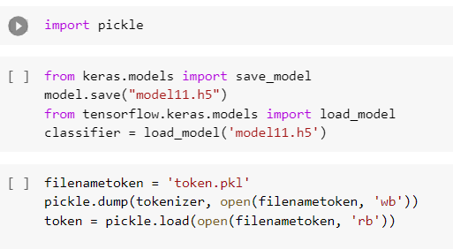
Create pickle file and H5 file
After model evaluation we got Nueral network have more accuracy(90%) than others so we have selected that model for deployment
First we have to import pickle and create pickle file with respect to model

Slide 39
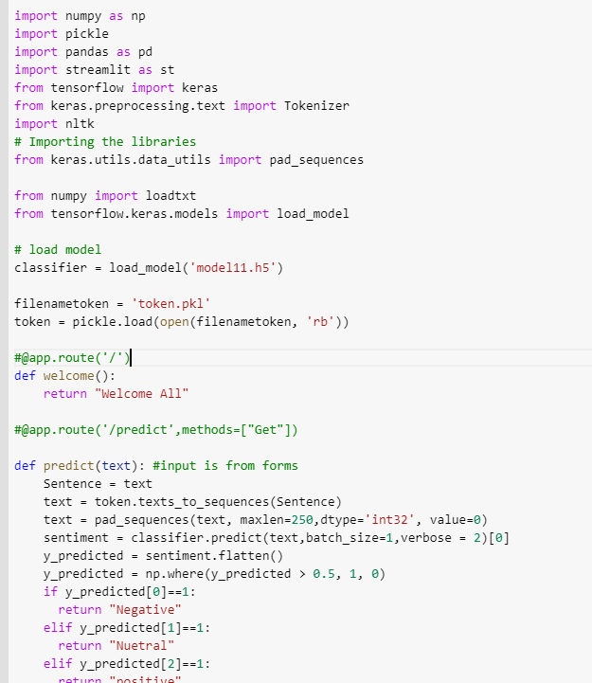
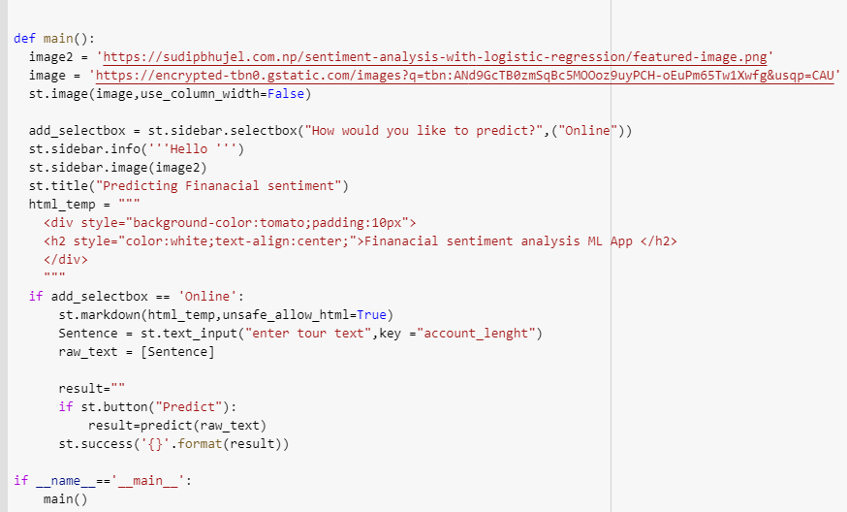
In spider we can develop app.py by imputing programme
Here we develop an app according to our model features and condition putting textbox
By this we get output such as “positive”, ”negative” and “neutral”

Slide 40
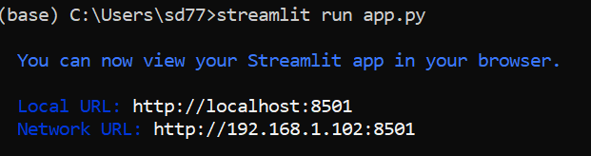
Then we have give path of app.py file for running into streamlit

Slide 41
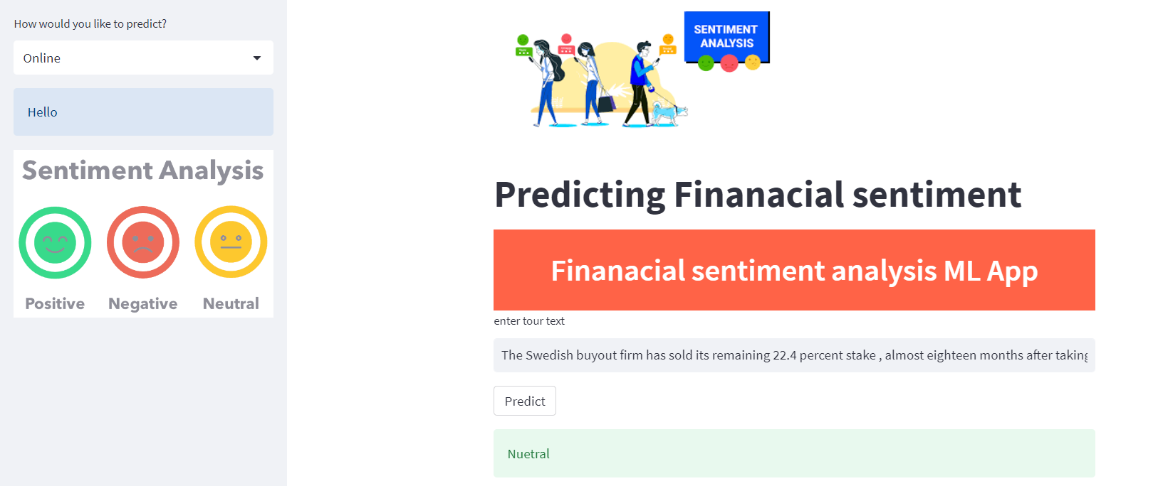
This is our streamlit page here we have added some visualizes form web
Adding information we get output

Slide 42
Thank you !

